Slide 1


Accelerated Database Recovery (ADR)
Available starting SQL Server 2019

Slide 2
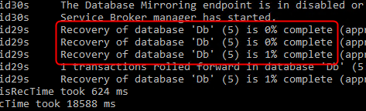
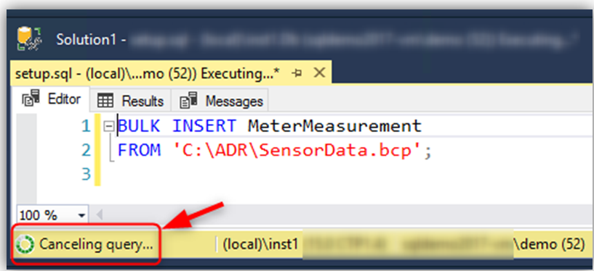

What is the problem?
Recovery time is roughly proportional to the longest running transaction.
Rolling back large batch operations (e.g. bulk insert) takes a long time.
Transaction log may run out of space during long-running transactions.

Slide 3
Customer Feedback
60% (48/80)
60% of customers surveyed have experienced more than 1 hour of production database unavailability due to long-running recovery.

Slide 4
Current Database Recovery Process (ARIES model)
Phase 1: Analysis
Determines the state of each transaction in the system at the time SQL Server stopped.
Phase 2: Redo
Returns the database to the state it was in at the time the SQL Server stopped.
[DB is PARTIALLY available after Redo]
Phase 3: Undo
Rolls back any uncommitted transaction(s) individually.
Log
Start
Oldest
uncommitted Tx
(XACT_BEGIN_LSN)
Checkpoint
(or oldest dirty page LSN)
Log
End
[DB is FULLY available after Undo]
Notes:
ARIES = Algorithm for Recovery and Isolation Exploiting Semantics
Diagram of the Transaction log, from START to END
Oldest uncommitted TX – this is the point from which the “active” portion of the log starts, all the way to the end of the log.
Checkpoint
Flushes dirty pages to disk (i.e., writes all changes made in memory to the data file)
Records the state of all active transactions at the time of the checkpoint
Records the LSN of the oldest dirty page in the buffer pool
Analysis Phase:
Identifies the oldest dirty page LSN (or latest LSN checkpoint)
Identifies any transactions that must be rolled back (uncommitted transactions)
Goal is to identify the log records required to perform REDO and UNDO
Redo Phase:
Requires SQL Server to perform a forward scan of the transaction log
Responsible for bringing the database back to the state it was at the time of the failure.
Scans the Tlog from the oldest active transaction to the end of the log
Re-does All operations committed since the last checkpoint but may not have been persisted to disk yet
Reason why REDO scans from the oldest active transaction is so that it can reacquire the locks held by the active transactions (i.e., uncommitted transactions)
Upon completion of this phase, database will be “partially” available. This is called FAST RECOVERY – an Enterprise only feature (starting 2005) that allows the part of the database that does not have the locks held by active transactions to be accessible to users.
Locks are released after the UNDO phase in order to render the database online
Undo Phase:
Rolls back all uncommitted transactions
Involves scanning the transaction log from the end to the beginning of the oldest uncommitted transaction.
Uses Compensation Log Records (to perform “anti-operation”, e.g.,. If DELETE, then INSERT. If INSERT, then DELETE, etc.)
Releases all locks rendering the database FULLY available.

Slide 5
Introducing…
ADR (Accelerated Database Recovery)
A SQL Database Engine feature introduced in SQL 2019 that greatly improves database availability by completely redesigning the current SQL Server recovery process, leading to the following benefits…
fast & consistent
database recovery
instantaneous
transaction rollback
aggressive log
truncation

Slide 6
Main Components of ADR
Persisted Version Store (PVS)
sLog
Cleaner
Logical Revert
A new mechanism for persisting row versions in the database itself rather than tempdb
Asynchronous process responsible for performing row-level version-based Undo
Secondary in-memory log stream that stores log records for non-versioned operations
Asynchronous process that periodically cleans row versions that are not needed
The key component that drives MVCC (Multi-Version Concurrency Control)
Notes:
PVS:
Stores row versions that are durable (survives restarts) since no longer stored in Tempdb.
Internally, uses 2 types of storage: in-row and off-row. In-row can store up to 200 bytes while for larger data, a 14-byte pointer is used instead to point to the off-row location.
Records in PVS contain transaction information and a pointer to the previous/older version.
Enables fast UNDO. Instead of rolling back the active transactions in the TLOG, ADR uses PVS to mark row versions as aborted.
LOGICAL REVERT
Async process that performs row-level version-based UNDO
Keeps track of all aborted transactions (in the Aborted Transaction Map)
Performs rollback (asynchronously) using PVS for all user transactions
Releases locks immediately after transaction termination.
Slog
In-memory log stream that stores non-versioned log records (e.g. lock acquisition, invalidate metadata cache, etc.) from system transactions
Persisted in the transaction log during checkpoint.
Reconstructred from Tlog dudring Analysis phase of recovery.
CLEANER
Async process (1 thread per database for SQL 2019 (sql 2022 uses multi-threading)) that periodically cleans row versions that are not needed.

Slide 7
Database Recovery (with ADR)
Phase 1: Analysis
Regular Analysis + Reconstructs sLog
Phase 2b: Redo
Phase 2a: Redo from sLog
Phase 2b: Redo from Transaction Log
Phase 2a: Redo from sLog
[DB is FULLY available after Redo]
Phase 3: Undo from sLog
Instant Undo by using sLog instead of Transaction Log
sLog Records
Transaction Log
sLog (in memory)
Log
Start
Oldest
uncommitted Tx
(XACT_BEGIN_LSN)
Checkpoint
(or oldest dirty page LSN)
Log
End
Log Record for non-versioned operation

Slide 8
How do I get it?
Azure SQL Database
Do nothing, it’s on by default!
SQL Server 2019
Do I need Enterprise Edition?
No. It’s in Standard!
ALTER DATABASE <db_name> SET ACCELERATED_DATABASE_RECOVERY = ON

Slide 9
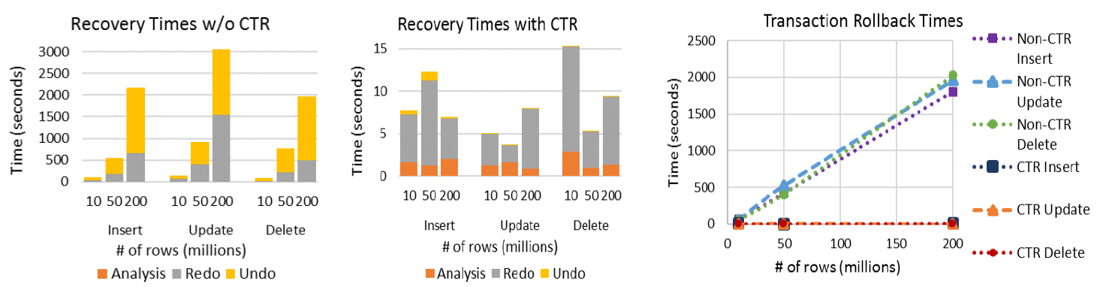
Recovery Time Comparison
https://www.microsoft.com/en-us/research/uploads/prod/2019/06/p700-antonopoulos.pdf
Notes:
This slide contains the results of the early testing of our product team with aim to compare the results of the recovery and transaction rollback times with and without ADR.
WHEN ADR IS OFF:
Analysis is performed in a constant time in all cases since it only processes the transaction log from the beginning of the last successful checkpoint.
On the other hand, Redo, Undo and transaction rollback scale linearly to the size of the transaction as they need to process all operations it performed.
WHEN ADR IS ON:
Recovery completes in almost constant time for all cases (w/ variance due to background checkpoint running and not related to the size of the transaction)
Analysis and Redo only process the log from the beginning of the last successful checkpoint and, therefore, complete in a small, constant amount of time.
Undo and transaction rollback are practically instant as all DML operations leverage Logical Revert and have no log records to be undone (SLog remains empty as there are no logical operations or updates to system metadata).
REFERENCE:
https://www.microsoft.com/en-us/research/uploads/prod/2019/06/p700-antonopoulos.pdf

Slide 10
Some FAQs
Will my database be larger?
Yes.
Will it affect performance?
It depends.
How is PVS different than the version store in tempdb?
PVS stores versions in the user database rather than tempdb
How does this affect Availability Groups?
If the secondary must be restarted
Testing is the only way to know for sure
Write-heavy (OLTP) workloads are most susceptible
If ADR is enabled, PVS is used to support SNAPSHOT and READ_COMMITTED_SNAPSHOT_ISOLATION transactions
PVS and log records replicate to secondaries, secondary communicates oldest versions needed to primary
ADR can speed up failover because Undo becomes fast
Without ADR, tempdb is lost so versions are lost and queries must wait for data to commit on primary
With ADR, versions are persisted, so no delay before queries can be served

Slide 11
Managing ADR
Enabling and Disabling ADR
ALTER DATABASE [DB] SET ACCELERATED_DATABASE_RECOVERY = {ON | OFF};
To enable ADR and specify that the PVS should be stored in a filegroup
ALTER DATABASE [MyDatabase] SET ACCELERATED_DATABASE_RECOVERY = ON
(PERSISTENT_VERSION_STORE_FILEGROUP = [VersionStoreFG]);
Examine the Persistent Version Store
SELECT * FROM sys.dm_tran_persistent_version_store_stats
Performing Manual Cleanup of PVS
EXEC sys.sp_persistent_version_cleanup [database_name];
Managing & Troubleshooting ADR (DMVs and Scripts)
Manage accelerated database recovery - SQL Server | Microsoft Learn
Troubleshoot accelerated database recovery - SQL Server | Microsoft Learn
Notes:
REFERENCE:
https://learn.microsoft.com/en-us/sql/relational-databases/accelerated-database-recovery-management?view=sql-server-ver16#enabling-and-controlling-adr
VERSION STORE STATS
- Helps you identify if the size of the ADR PVS is growing larger than expected and which factor is preventing PVS from being cleaned up
MANUAL CLEAN-UP
Something that you might want to do between workloads or during maintenance windows
Btw, starting SQL 2022, clean-up failures are reflected in the errorlog.

Slide 12
Who should consider using ADR?
Workloads with unavoidable long running transactions
Workloads with a history of database unavailability due to long running recovery
NOT for high-volume OLTP without period of rest/recovery
Workloads with active transactions causing significant TLOG growth

Slide 13
ADR Enhancements in SQL 2022
Multi-threaded Version Cleanup
Reducing Memory Footprint for PVS Page Tracker
Transaction-level PVS
New XE Event
User Transaction Cleanup
Notes:
1) MULTI-THREADED VERSION CLEANUP
In SQL Server 2019 (15.x), the cleanup process is single threaded within a SQL Server instance.
Beginning with SQL Server 2022 (16.x), this process uses multi-threaded version cleanup. This allows multiple databases in the same SQL Server instance to be cleaned in parallel. This improvement is valuable when you have multiple large databases.
To adjust the number of threads for version cleanup scalability, set ADR Cleaner Thread Count with sp_configure. The thread count is capped at the number of cores for the instance.
As a best practice, we recommend using the same number of ADR cleaner threads as the number of your databases. For instance, if you configure the ADR Cleaner Thread Count to be 4 on a SQL Server instance with two databases, the ADR cleaner will still only allocate one thread per database, leaving the remaining two threads idle.
EXEC sp_configure 'ADR Cleaner Thread Count', '4'
RECONFIGURE WITH OVERRIDE;
2) USER TRANSACTION CLEANUP
Clear pages that could not be cleaned by the regular process due to lock failure.
This feature allows user transactions to run cleanup on pages that could not be addressed by the regular cleanup process due to table level lock conflicts. This improvement will help ensure that the ADR cleanup process does not fail indefinitely because user workloads cannot acquire table level locks.
3) Reducing memory footprint for PVS page tracker
This improvement tracks persisted version store (PVS) pages at the extent level, in order to reduce the memory footprint needed to maintain versioned pages.
4) Transaction-level PVS
This improvement allows ADR to clean up versions belonging to committed transactions independent of whether there are aborted transactions in the system. With this improvement persisted version store (PVS) pages can be deallocated, even if the cleanup cannot complete a successful sweep in order to trim the aborted transaction map. The result of this improvement is reduced persisted version store (PVS) growth even if ADR cleanup is slow or fails.
5) New XE Event
A new extended event, tx_mtvc2_sweep_stats, has been added for telemetry on the ADR PVS multi-threaded version cleaner.
Reference:
https://learn.microsoft.com/en-us/sql/relational-databases/accelerated-database-recovery-concepts?view=sql-server-ver16#adr-improvements-in-

Slide 14
Learn more about ADR
Accelerated database recovery - SQL Server | Microsoft Learn
Manage accelerated database recovery - SQL Server | Microsoft Learn
Troubleshoot accelerated database recovery - SQL Server | Microsoft Learn
Constant Time Recovery (a.k.a. ADR), in SQL Server - White Paper
Accelerated Database Recovery enhancements in SQL Server 2022 - Microsoft SQL Server Blog

Slide 15

Demo

Slide 16

Thank you!

